Slide 1
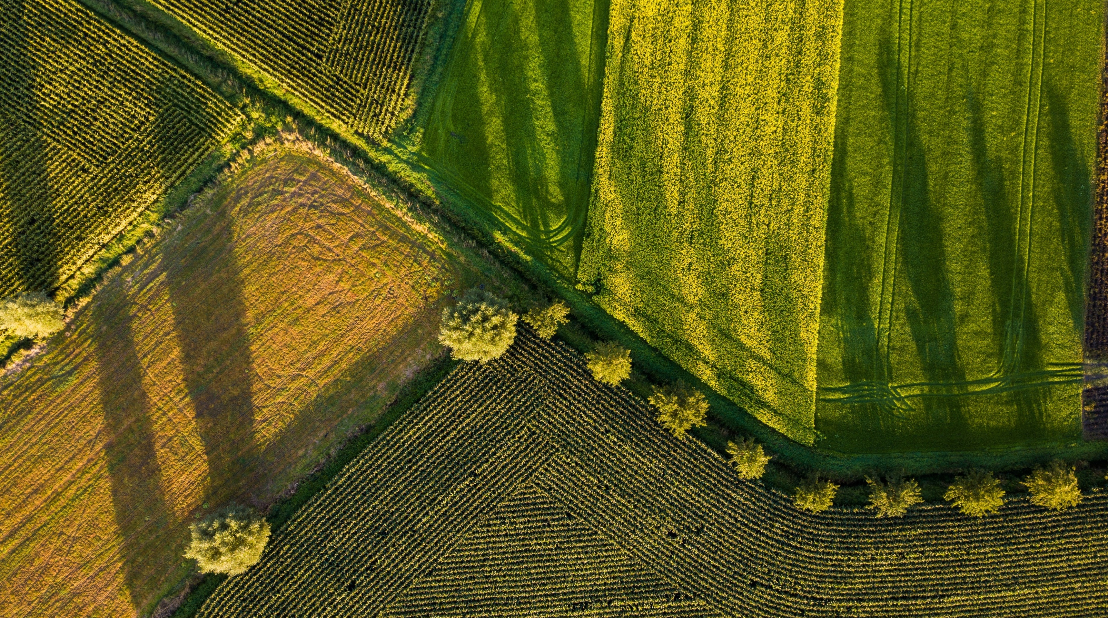

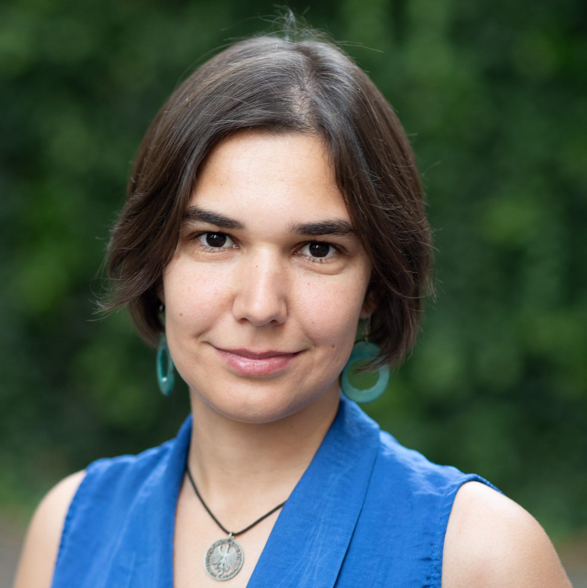

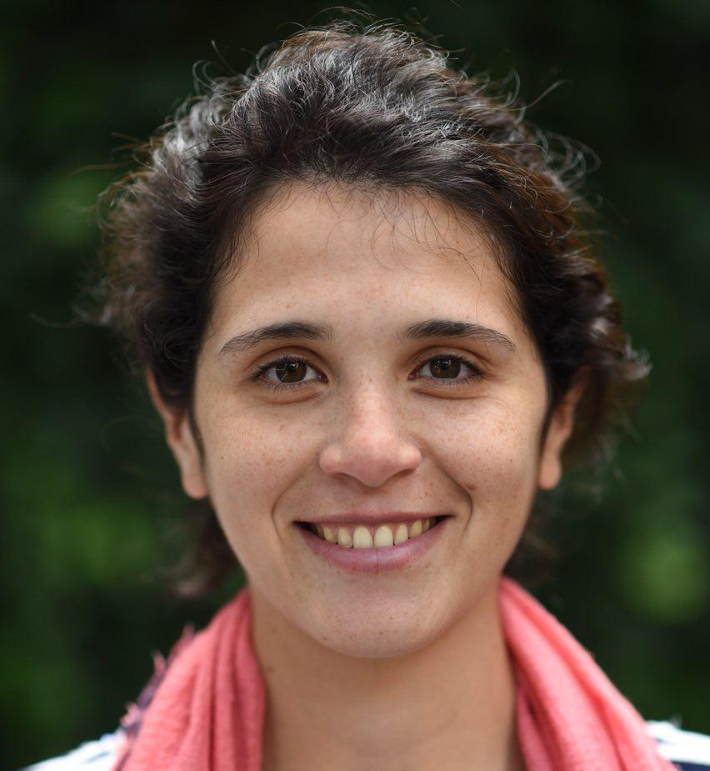
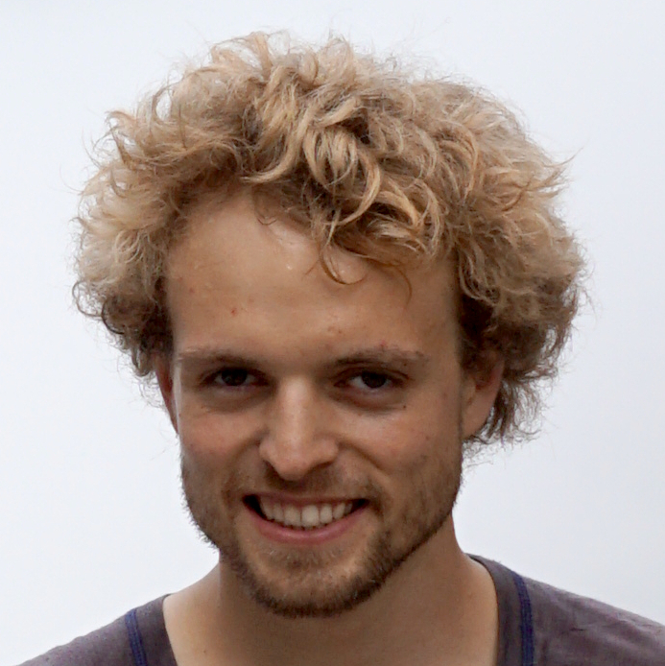
Bühler Group Challenge
THE REAL COST OF FOOD
Sebastian
Mariana
Betiana
Gregor

Slide 2

EatWise
Eat it. Drink it. Save it.

Slide 3
Process Overview
Shopping List
Supermarket Request
Validate purchase
Save quantities
Calculate total cost
Normal. weight
Weekly basket reference
Select items
Visualize their cost
Challenge friend
Visualize ranking
Select a friend
Challenge
Wait for friend
Evaluate Challenge
Win or loose

